Slide 1
New Delayed Message In Pulsar 3.0
Cong Zhao
2023.10.14

Slide 2

Self-Introduction
Cong Zhao (@Coderzc)
StreamNative Software Enginner
Apache Pulsar Committer

Slide 3
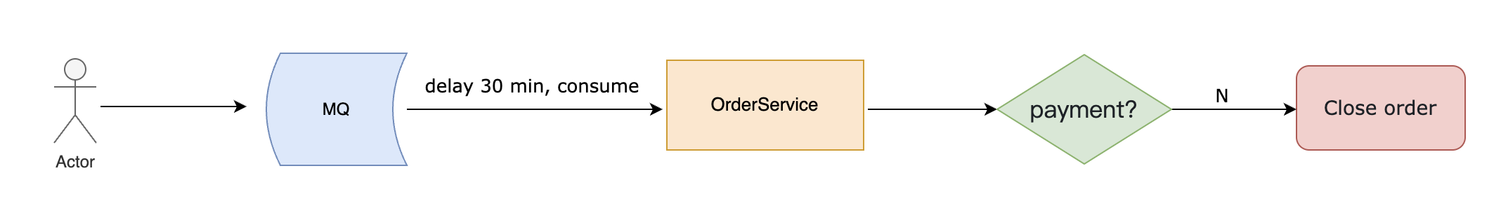
What’s delayed message
How to implement closing timeout for unpaid orders?

Slide 4
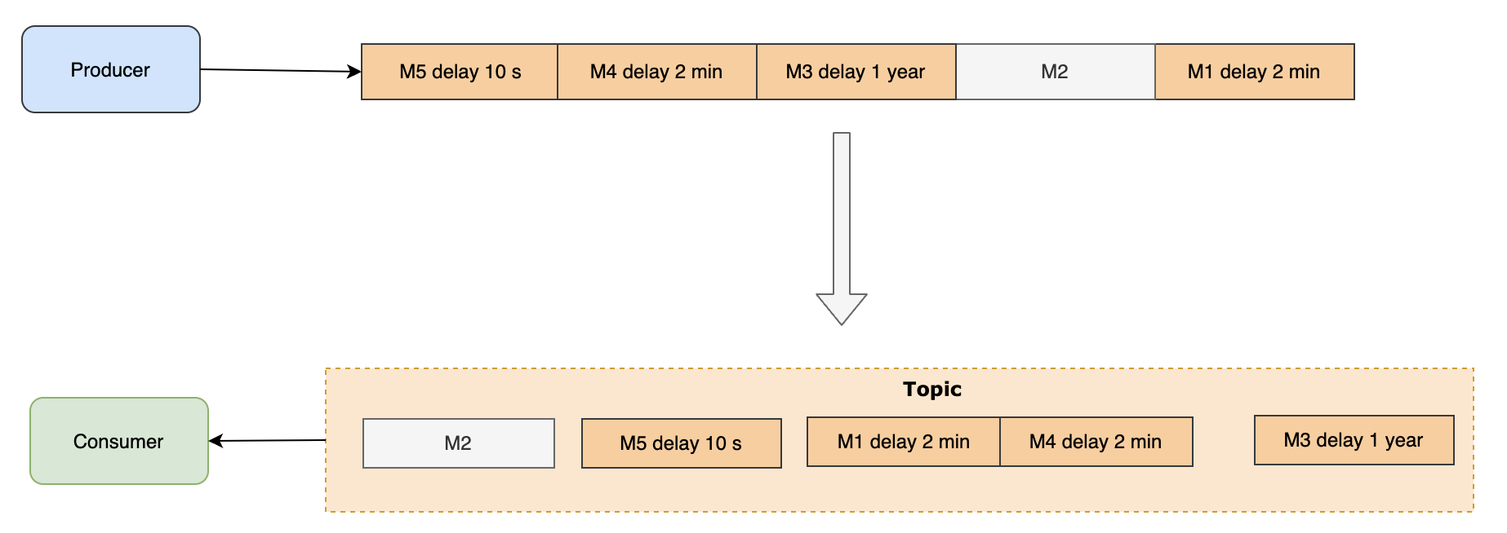
Delayed Message In Pulsar

Slide 5
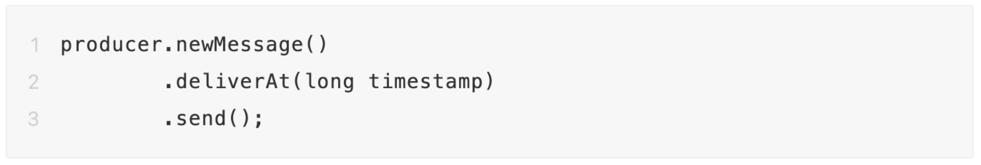
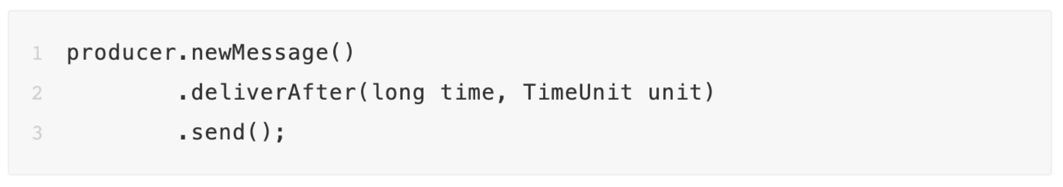
How to use delayed message in Pulsar
deliverAt send
deliverAfter send

Slide 6
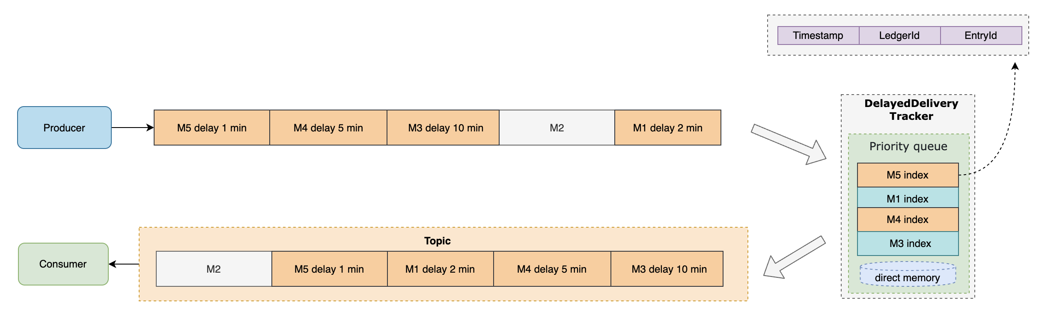
How delayed message work in Pulsar

Slide 7
Challenges of Pulsar’s delayed message
Delayed index queue is limited by memory
A broker's memory is not infinite. For scenarios where users need to store many delayed messages, the in-memory priority queue might be a bottleneck for maintaining an extensive delayed index.
Expensive delayed index rebuilding
To rebuild the delayed index, the broker needs to read all delayed messages of a topic. If there are too many delayed messages on a topic, the index rebuilding might take a long time, a few minutes to a few hours.

Slide 8
Objectives of new delayed message
Makes the scale of a delayed message not limited by the memory.
Support delayed message index snapshot to avoid the high index rebuild costs.

Slide 9
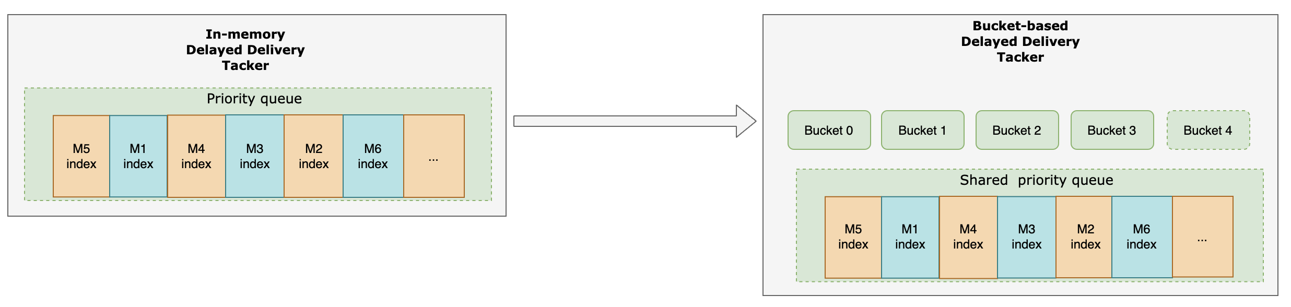
Design of new delayed message

Slide 10
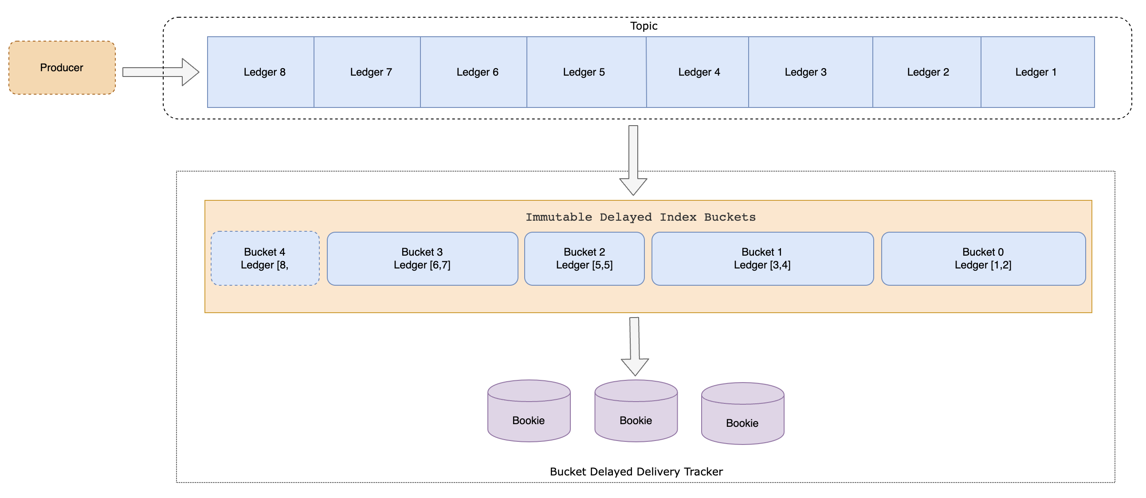
Design of new delayed message

Slide 11
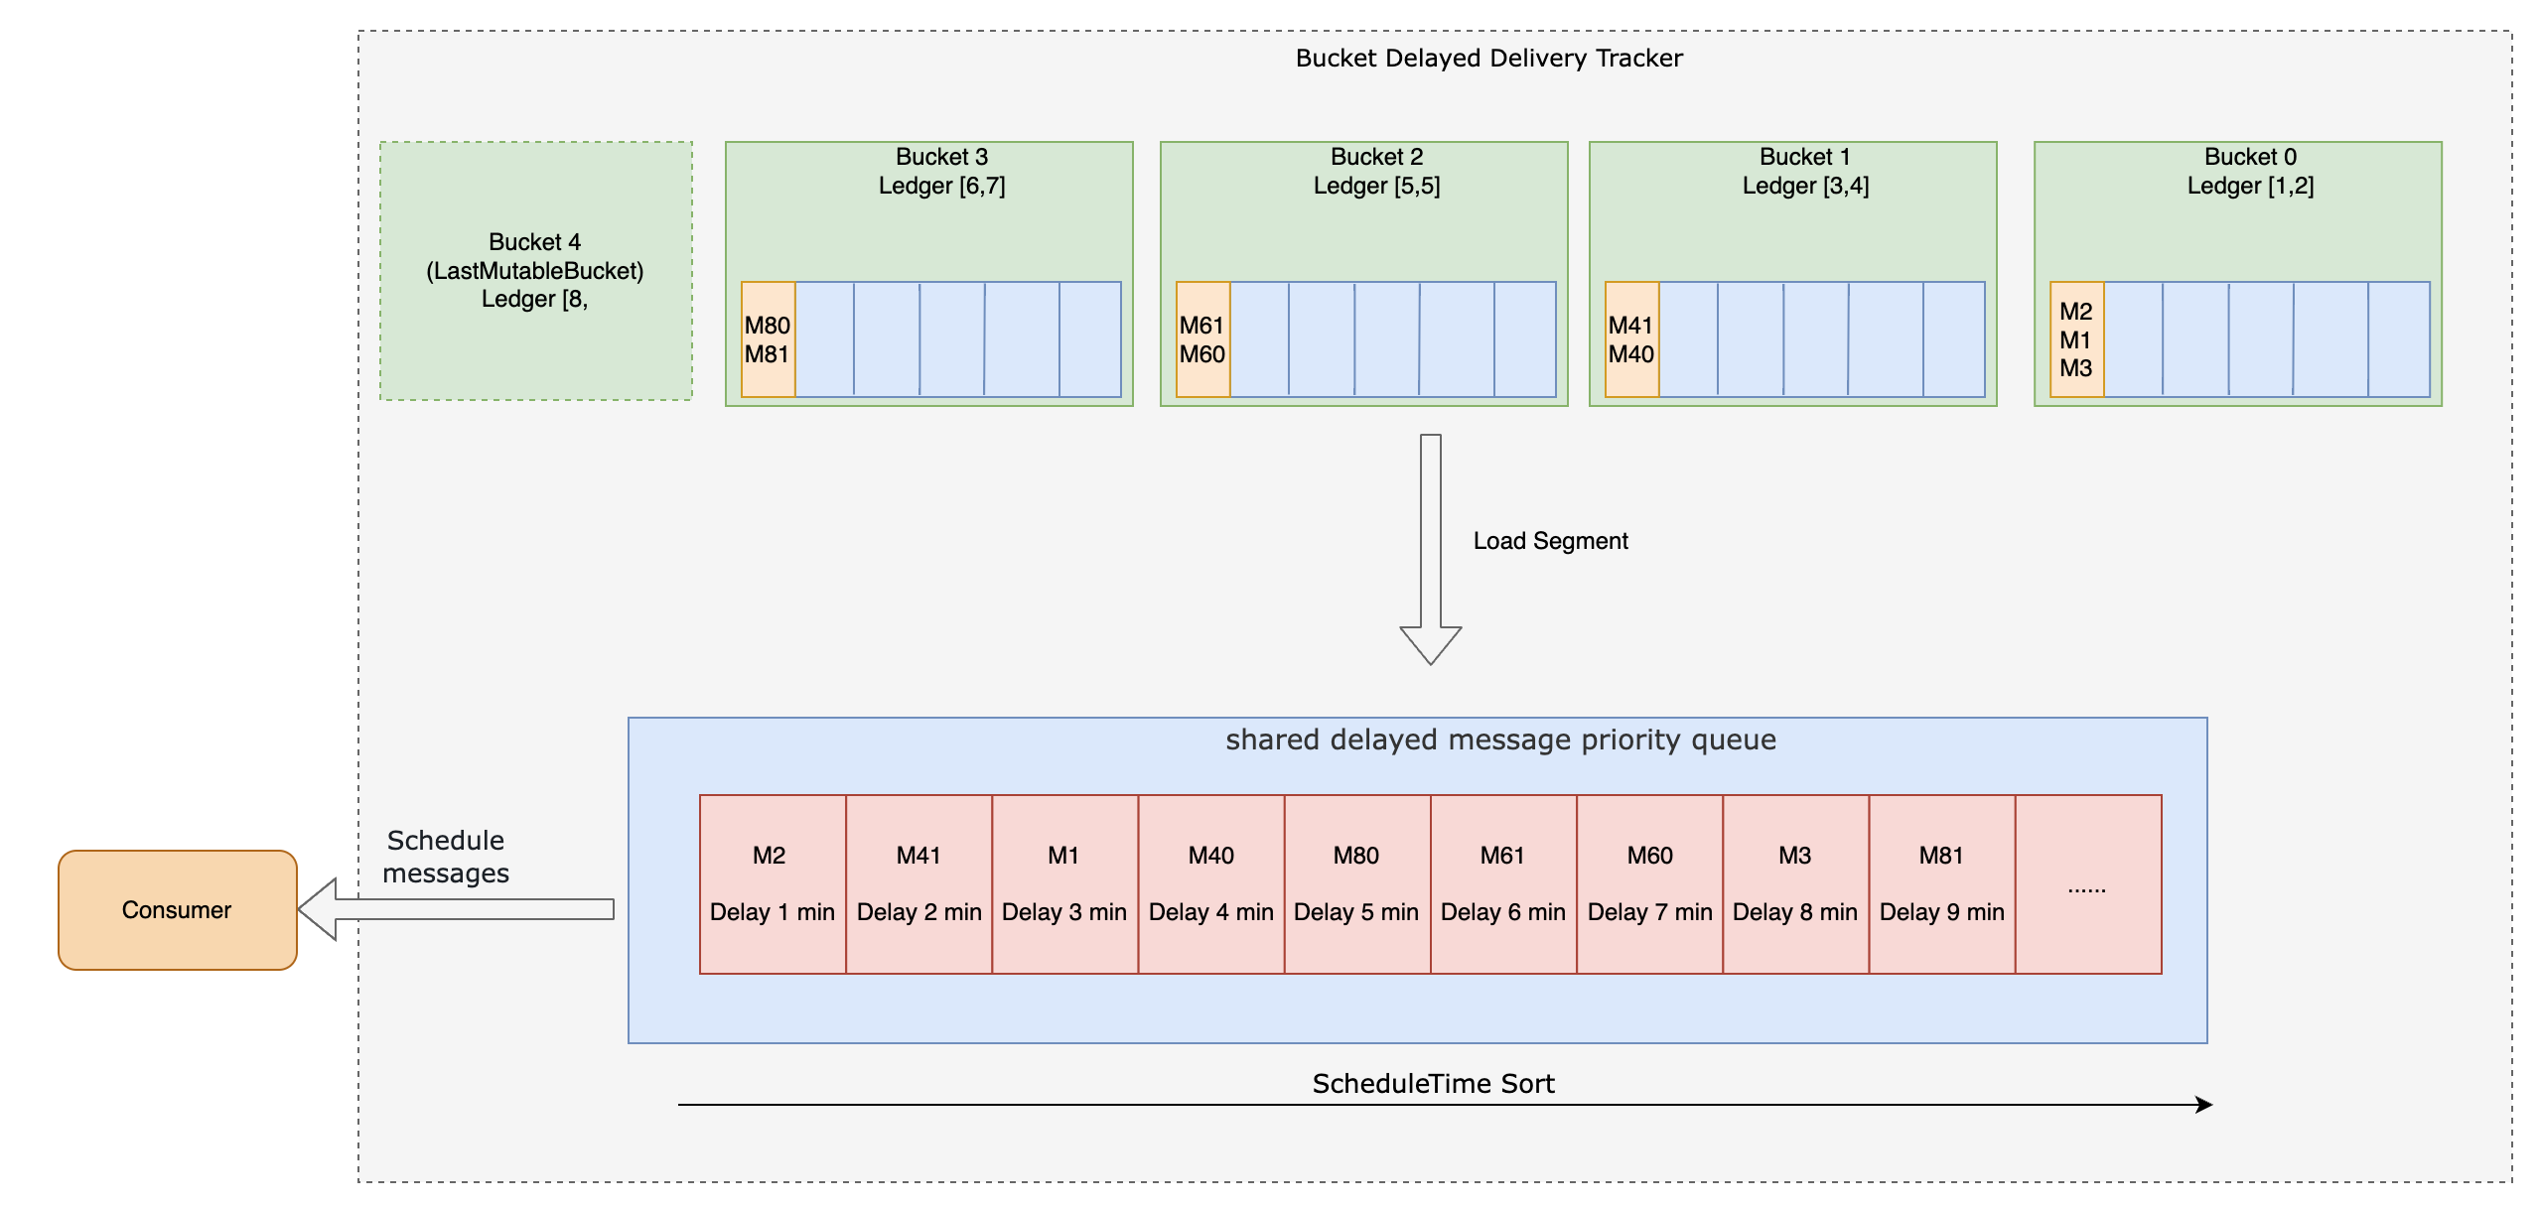
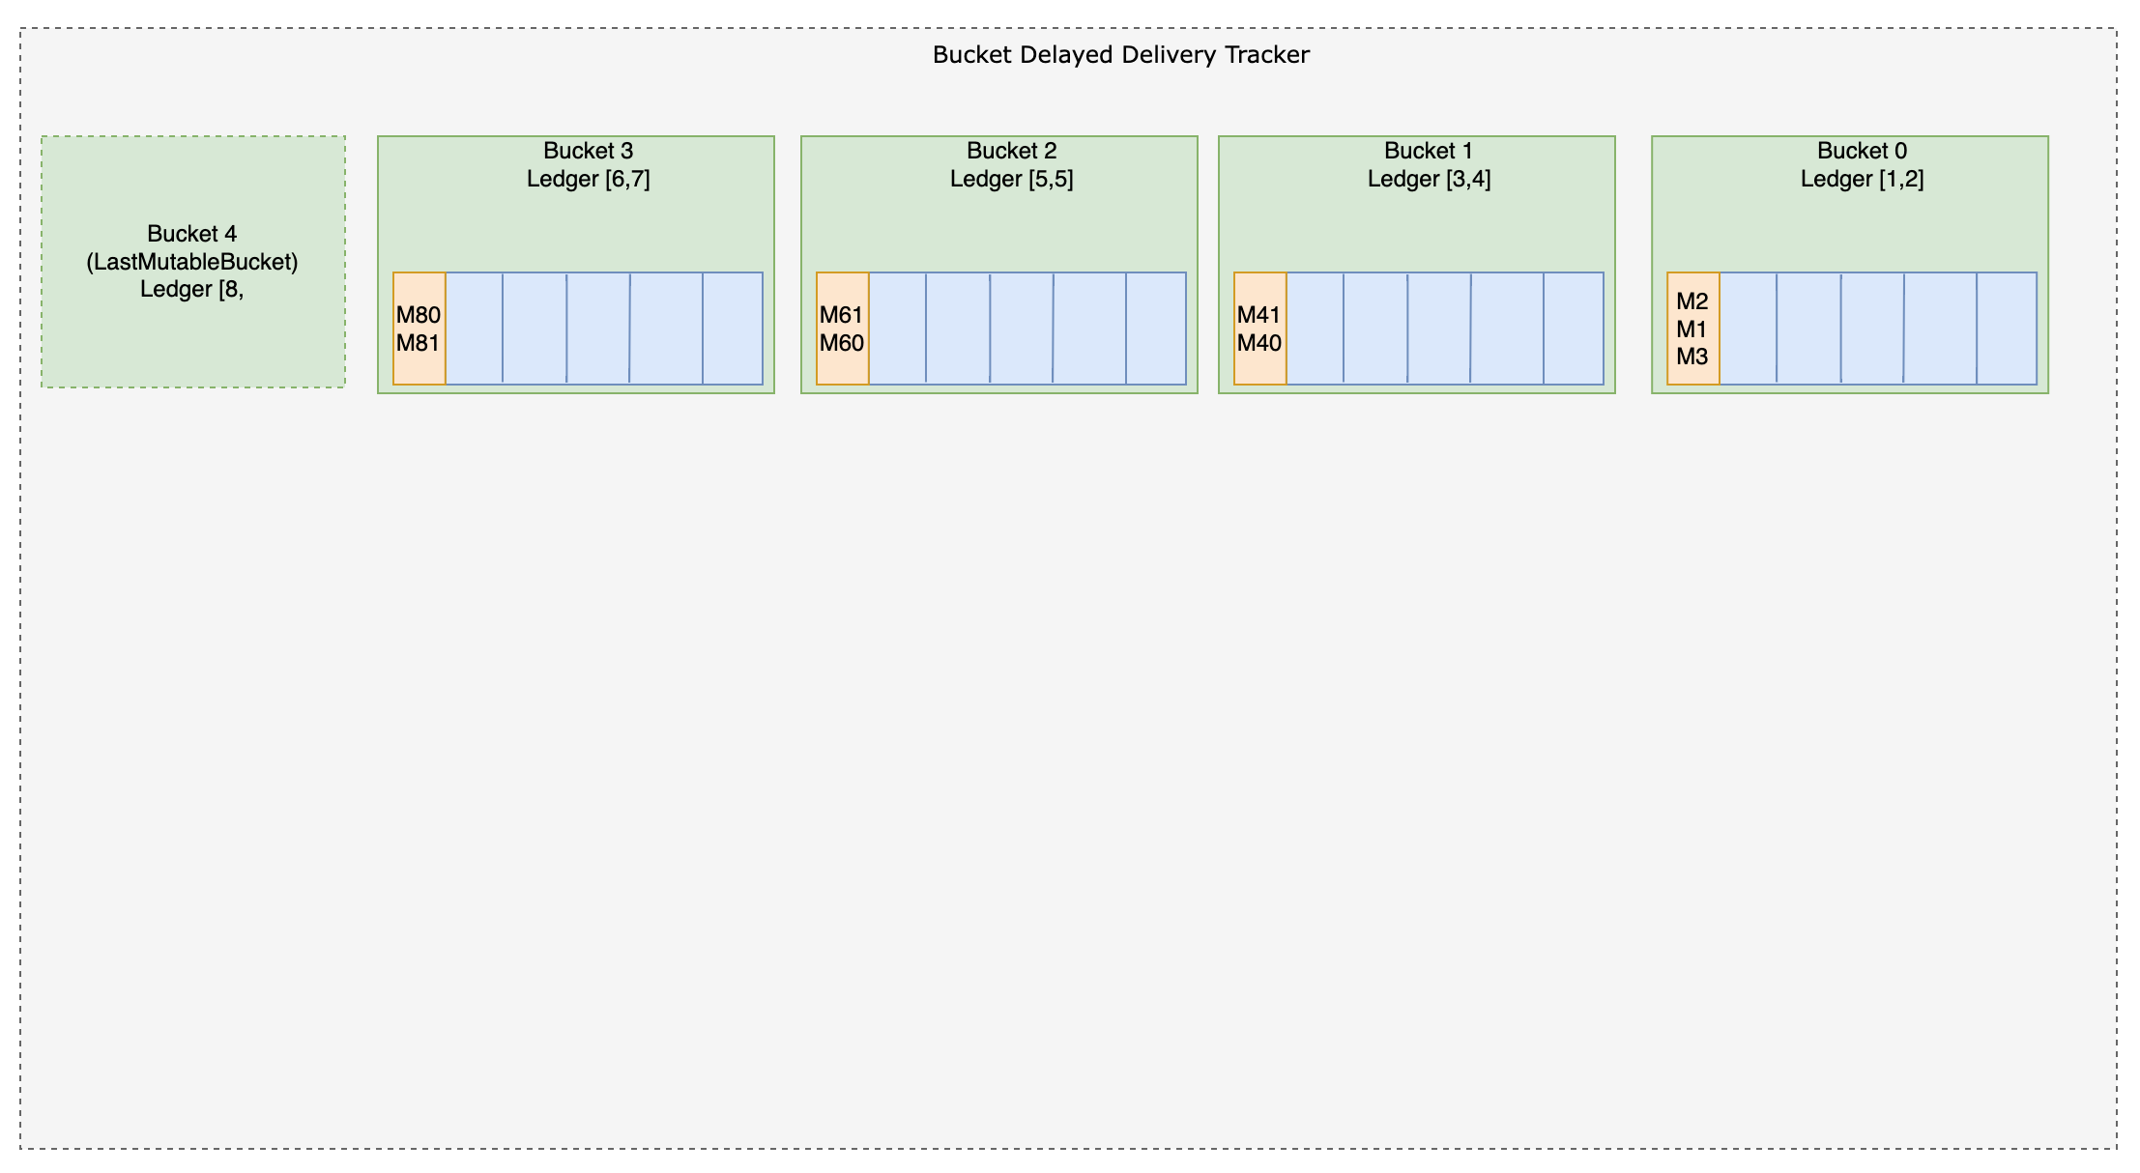
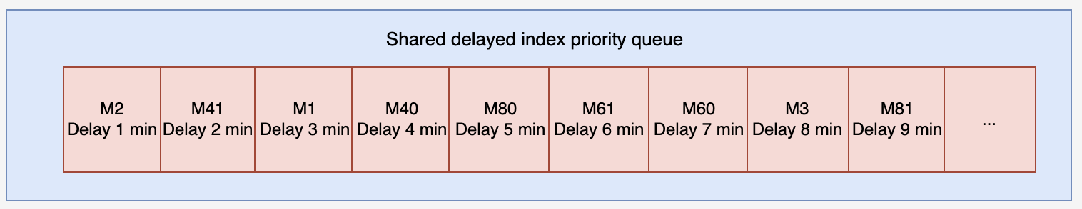
Design of new delayed message

Slide 12
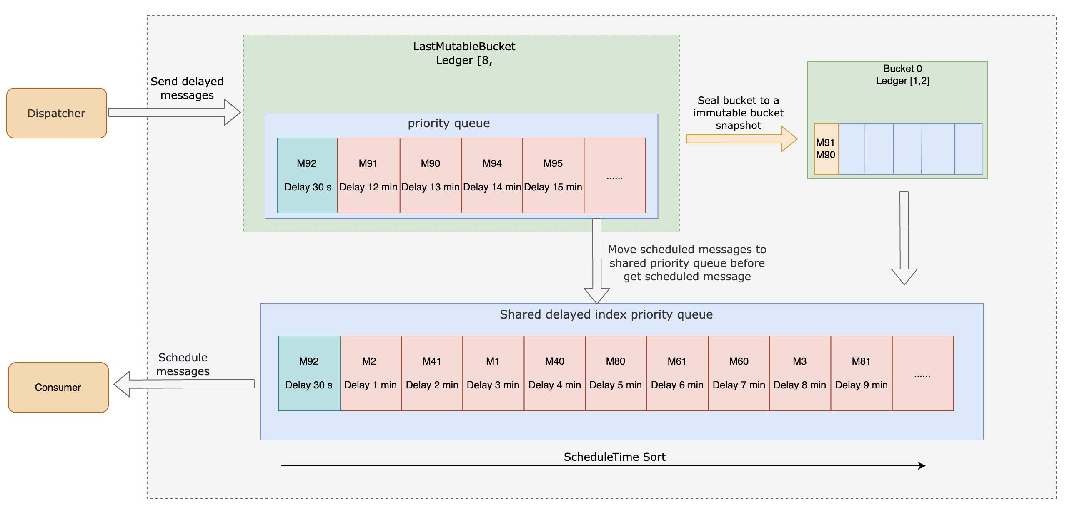
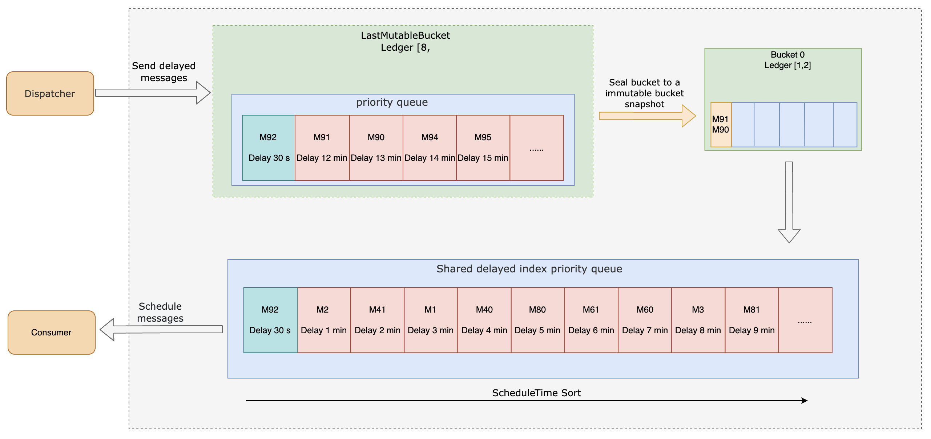
Design of new delayed message

Slide 13
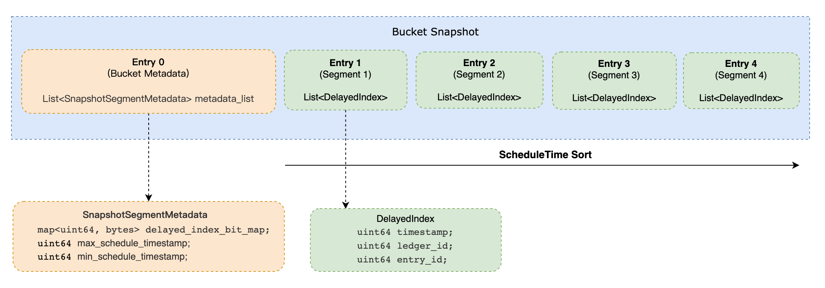
Design of new delayed message

Slide 14
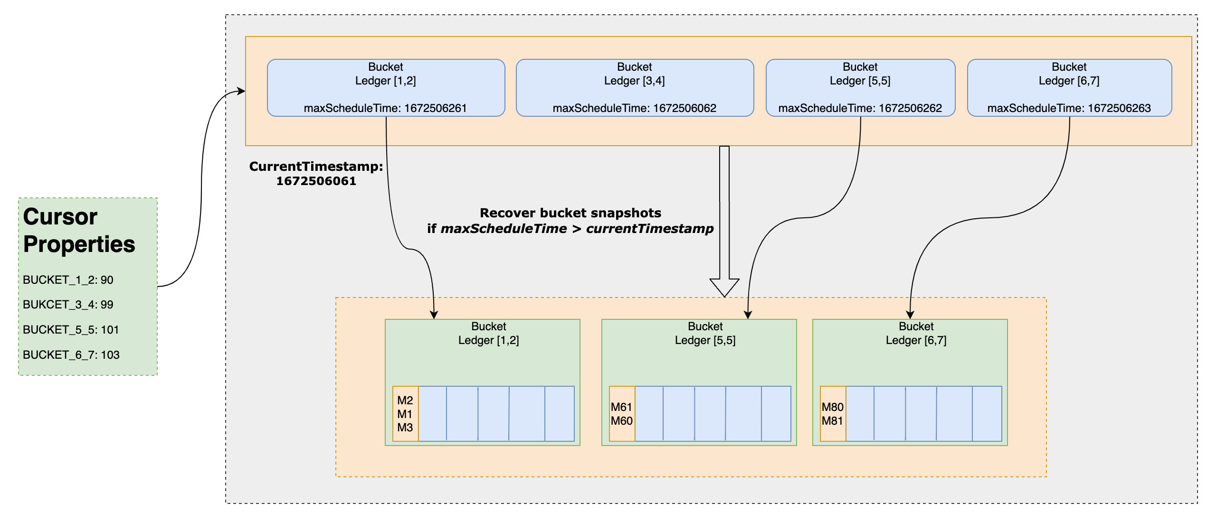
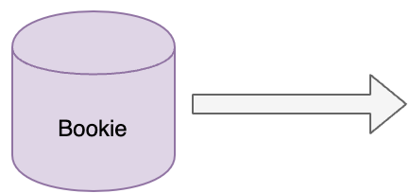
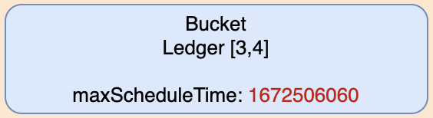
Design of new delayed message

Slide 15
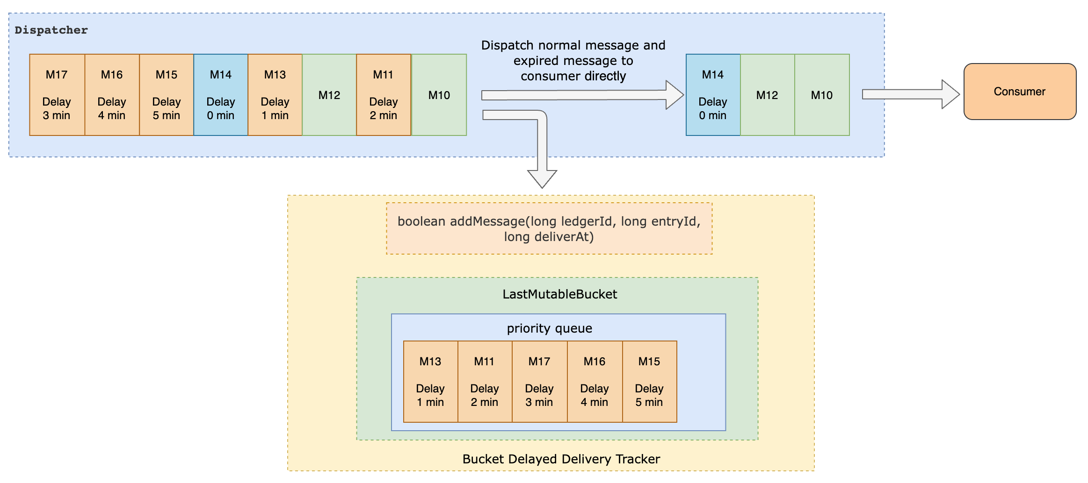
Design of new delayed message

Slide 16
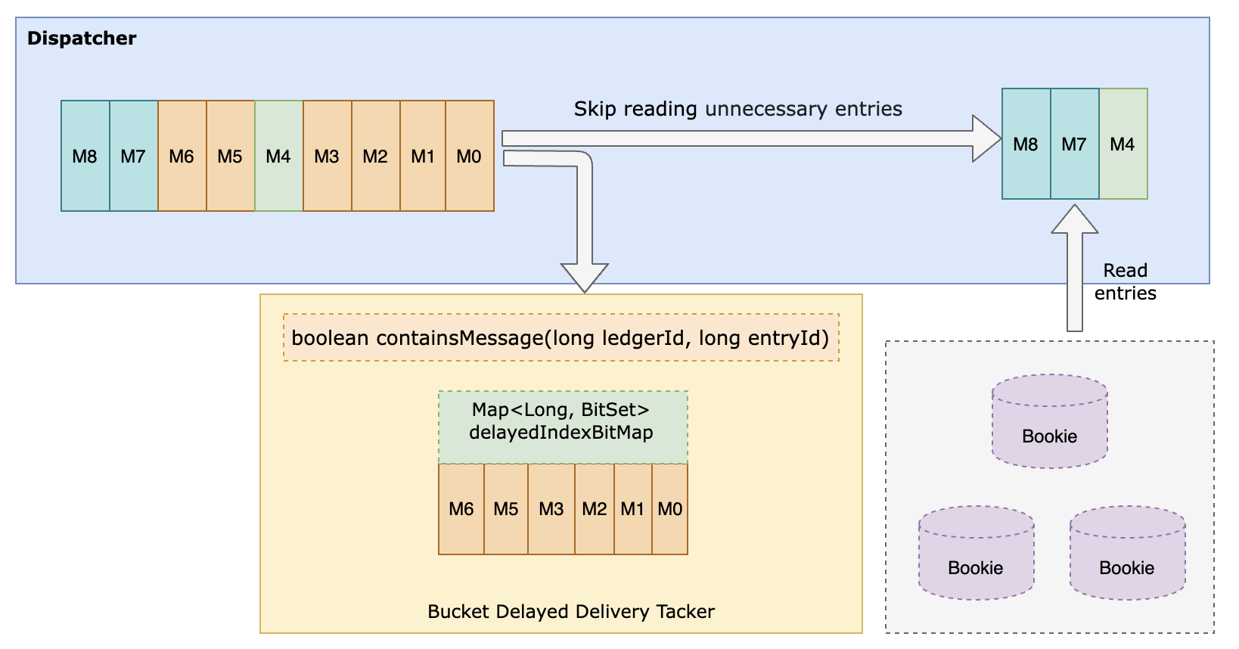
Design of new delayed message

Slide 17
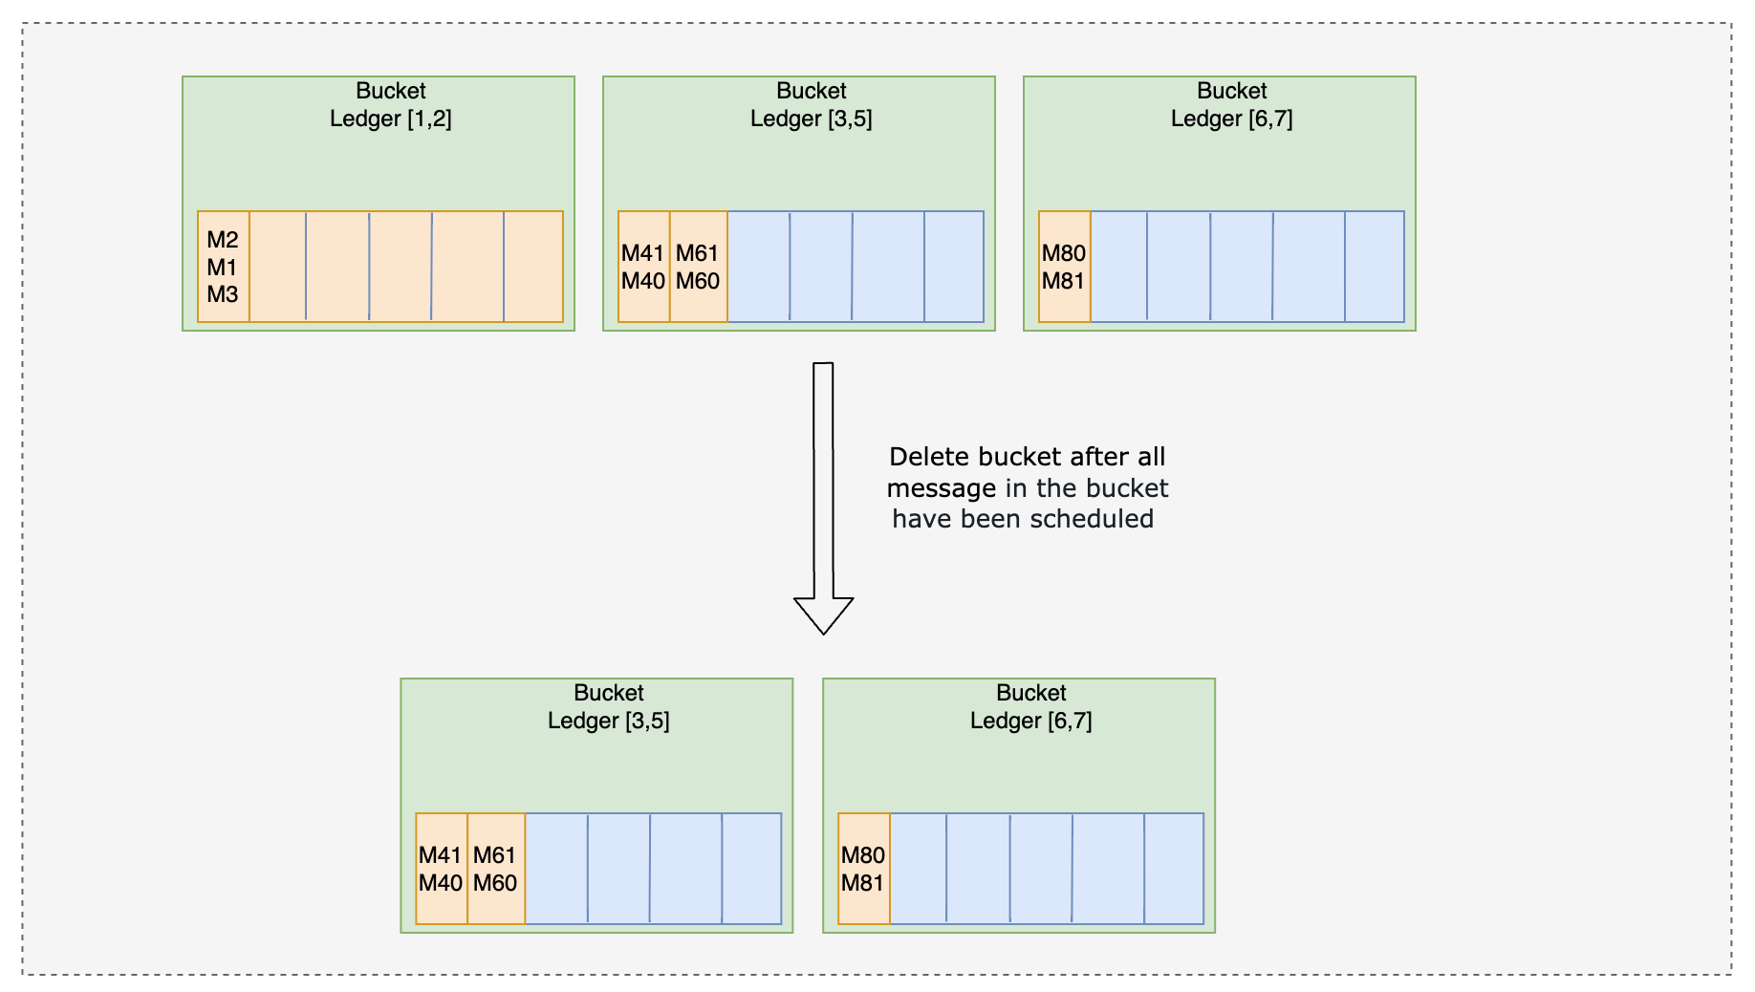
Design of new delayed message

Slide 18
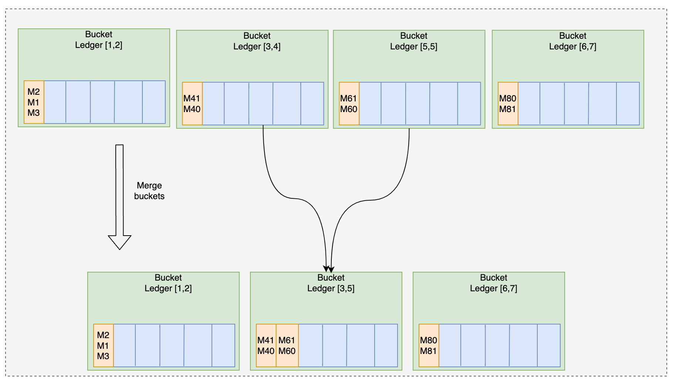
Design of new delayed message

Slide 19
Delayed message benchmark
We are using StreamNative Cloud basic minimal-size cluster with Apache Pulsar 3.0.4 for benchmarking.
The display after converting the units to standard units is as follows.
 | Instance Number | CPU | Heap Memory (MB) | Direct Memory (Byte)
Broker | 2 | 400m | 820 | 820
Bookie | 3 | 400m | 410 | 820

Slide 20
Delayed message benchmark
Relying on the pulsar-perf, we are testing 100Mil delayed messages with the random delay time.
Command Producer:
bin/pulsar-perf produce persistent://public/default/delayed-message -dr 172800,173400 -m 100000000 -r 1000
Command Consumer:
bin/pulsar-perf consume persistent://public/default/delayed-message -ss subs -st Shared -r 1000

Slide 21
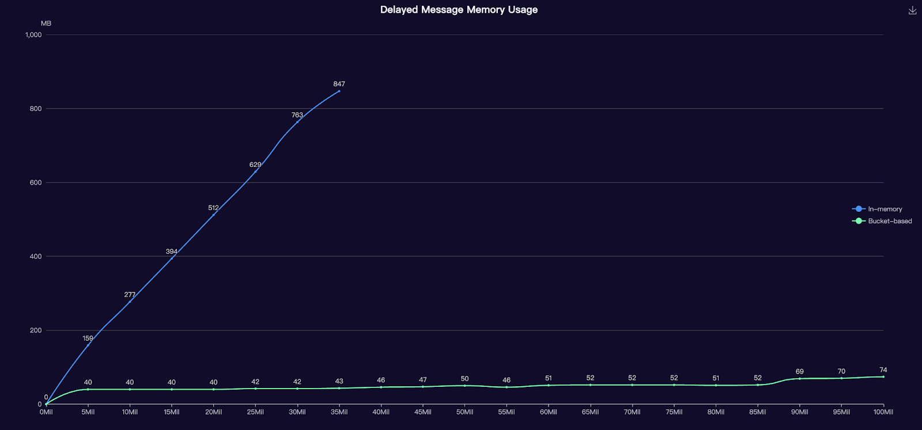

Delayed message benchmark
Out Of Memory

Slide 22
Delayed message benchmark
Recovery time comparative
 | Number Of Messages | Recovery Time (sec)
In-Memory | 35Mil | 6120
Bucket-Based | 100Mil | 90

Slide 23
Delayed message benchmark
Conclusions
The new bucket-based delayed message mechanism is not limited by memory, allowing users to retain a large number of delayed messages.
The new bucket-based delayed message mechanism significantly reduces the recovery time for delayed messages when migrating a topic to a different broker or recovering from broker downtime.

Slide 24
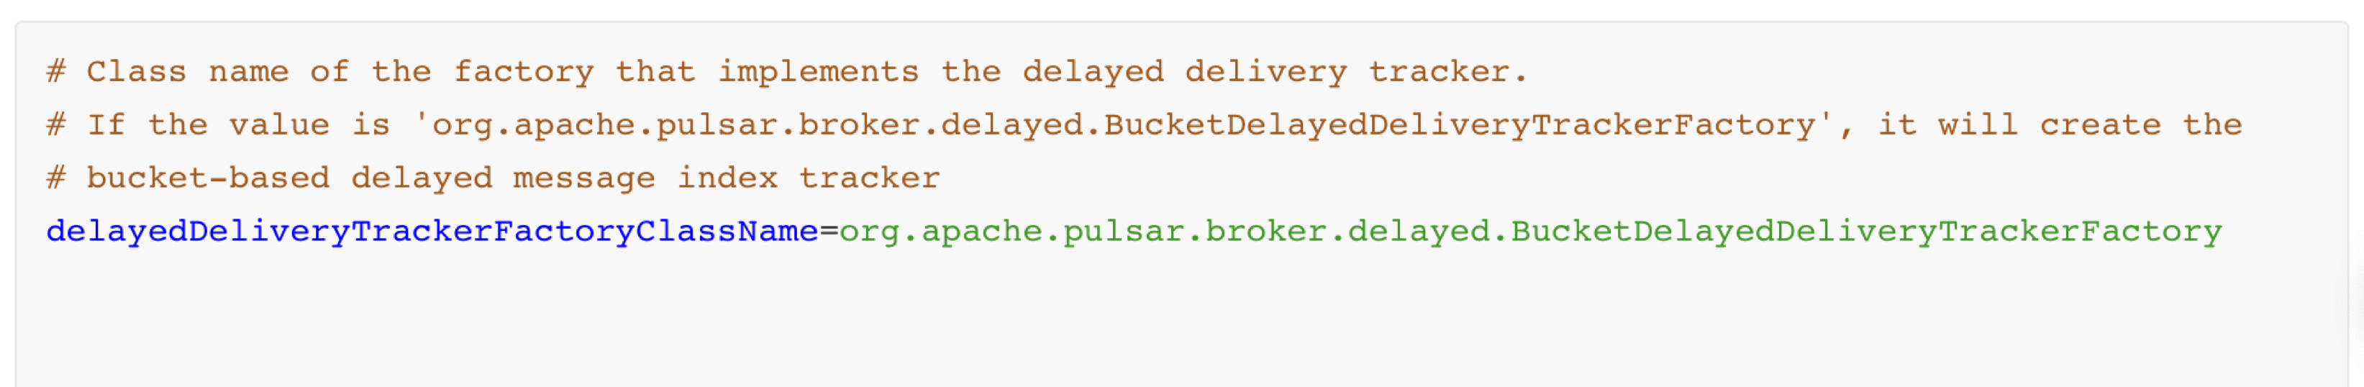
How to enable new delayed message
broker.conf
PIP-195: https://github.com/apache/pulsar/issues/16763

Slide 25

Welcome to upgrade to Pulsar 3.0
Pulsar 3.0 Announcement Blog: https://pulsar.apache.org/blog/2023/05/02/announcing-apache-pulsar-3-0/

Slide 26
Thanks

